Slide 1
Big Data Management and Analytics
3. Spark Program
Notes:
<number>

Slide 2
Learning Outcomes
Upon completion of this lesson, students will be able to:
Install Pycharm IDE
Install Anaconda distribution
Run a python program
Notes:
<number>

Slide 3
IDE Setup
Use IDE like Eclipse/Intellij IDEA/PyCharm
Programming Language Support: Java, Scala, Python
Install Maven/SBT plugins
You can use SBT or Maven for Scala/Java project.
Documentation for SBT setup in IntelliJ Idea
https://www.jetbrains.com/help/idea/creating-and-running-your-scala-application.html
Documentation for Maven setup in intellij idea
https://www.jetbrains.com/help/idea/maven.html
Note that spark supports java 8+ and Scala 2.11

Slide 4
Download and Install PyCharm
Download PyCharm
Mac
https://www.jetbrains.com/pycharm/download/#section=mac
Linux
https://www.jetbrains.com/pycharm/download/#section=linux
Unzip downloaded file and install it
Similar process as Intellij IDEA (shown in Hadoop installation guide)

Slide 5
Anaconda Installation Guide
Download Anaconda
Mac
https://www.anaconda.com/download/#macos
Linux
https://www.anaconda.com/download/#linux
Note that Pyspark supports Python 2.7+/3.4+
Install Anaconda
Make sure at the end of installation, let anaconda modify your PATH variable by adding anaconda path in front of your PATH variable

Slide 6
Anaconda Installation Guide

Slide 7
PyCharm and python
Close current terminal and re-open a new terminal
Type following command to check current python version:
python –version
PySpark has been merged into repository
To use pyspark only, simply install it using following command

Slide 8
Open PyCharm
To open PyCharm, type the following command in terminal:

Slide 9
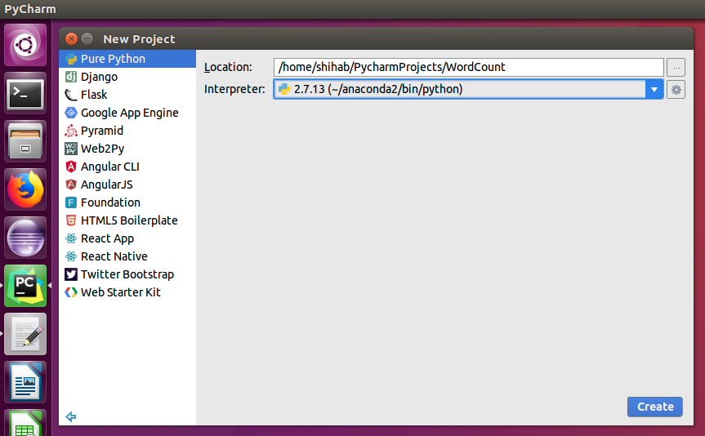
Create a Project in PyCharm
Create a project in PyCharm and select anaconda python interpreter

Slide 10
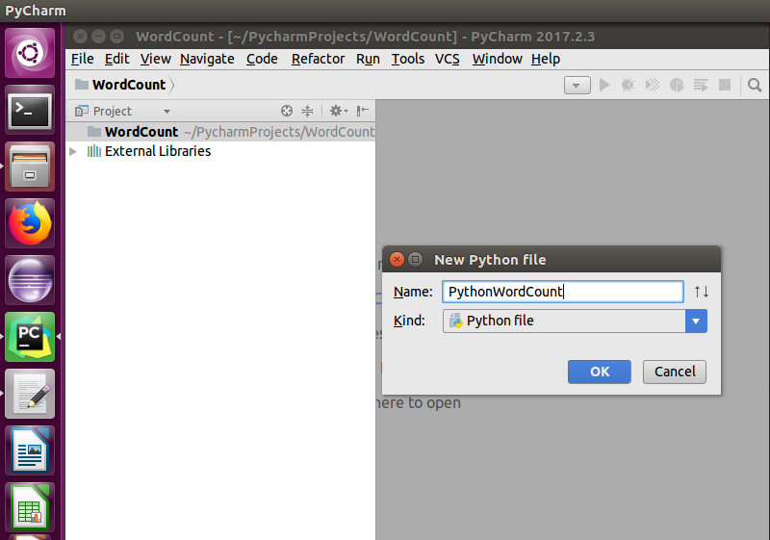
Create Python file
Create a Python file
For example, name the file PythonWordCount
Copy all the code in wordcount.py into this file

Slide 11
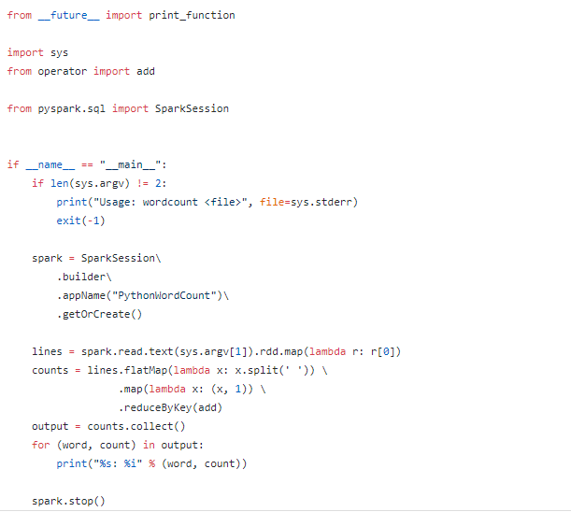
wordcount.py
Source: https://github.com/apache/spark/blob/master/examples/src/main/python/wordcount.py

Slide 12
Create input file
Create a file that contains some words (for example, test.txt)

Slide 13
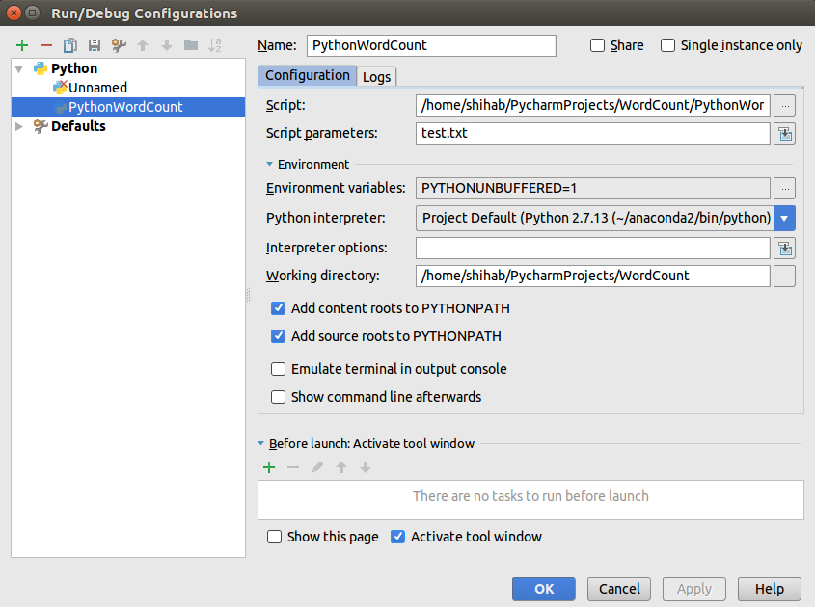
Configure Script Parameters in PyCharm
Click on
Run -> Edit Configurations…
In ‘Script parameters:’ field, enter the full path of the input file that was created in the previous step

Slide 14
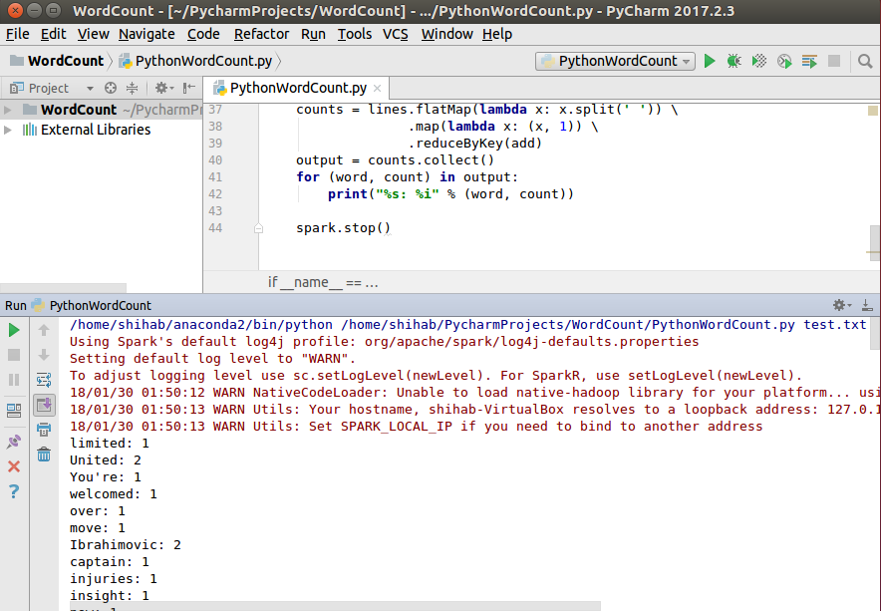
Run Program in PyCharm
Click on
Run -> Run ‘PythonWordCount’
Or
Run -> Run…
Output will show in the console

Slide 15
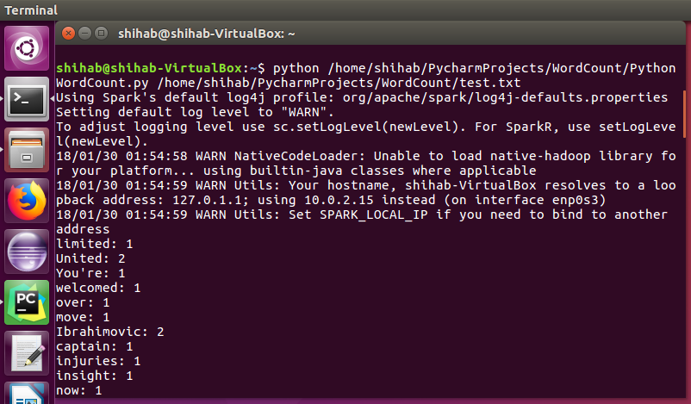
Run Program in shell
Open Terminal
Enter the following command:
python <path to PythonWordCount.py> <path to test.txt>

